Slide 1
QHPC EX #1
By: Ryan Silverberg

Slide 2
Agenda
Why does HPC exist?
Parallel Programming
Scalability

Slide 3
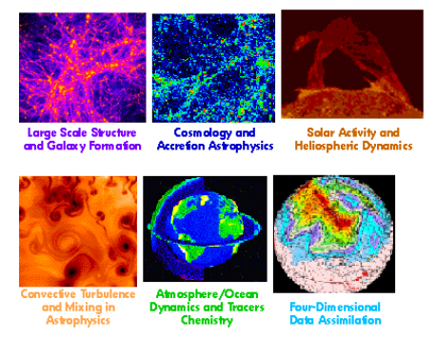
Grand Challenge Problems

Slide 4
End of Moore’s Law
Lack of ILP
Performance is flattening out
MPP, DLP, TLP, DSAs

Slide 5
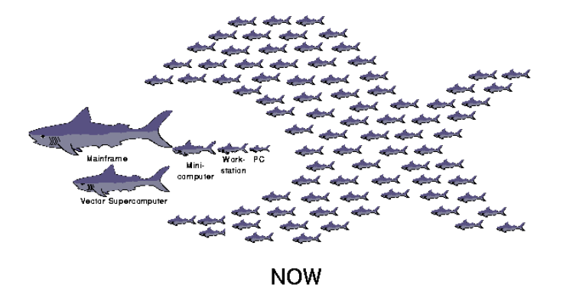
Solutions
Vector Machines
MPPs
SMPs
NUMA
Clusters (86.2% of Top500)

Slide 6
Parallel Programs

Slide 7
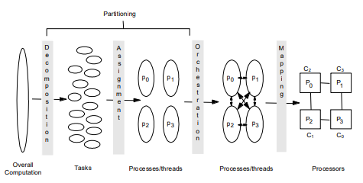
How do we make a parallel program?

Slide 8
Programming Models
Shared Memory
Message Passing
Data Parallel
Bulk Synchronous
PGAS
Hybrid
What is the cost of communication?

Slide 9

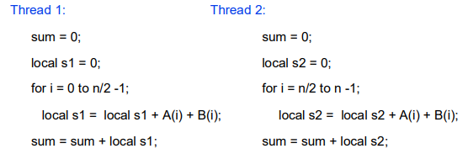
Example

Slide 10
Example
Problem: Both threads can write at the same time (race condition)
We need synchronization, only one has control at a time.

Slide 11
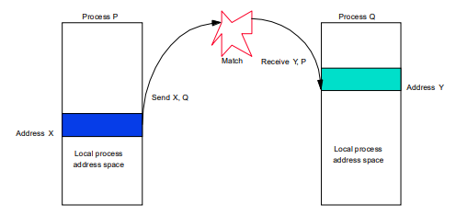
Message Passing
Named Processes
Data transfer is explicit
Coordination is implicit

Slide 12
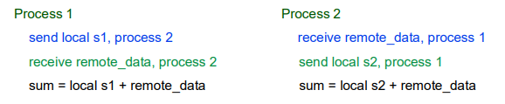
Example
Sum of 100k numbers on 100 processors

Slide 13

Example
Sum of 100k numbers on 100 processors

Slide 14
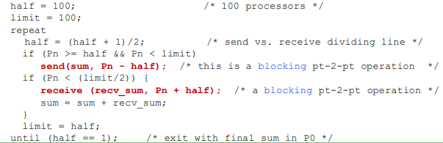
Example
Sum of 100k numbers on 100 processors

Slide 15
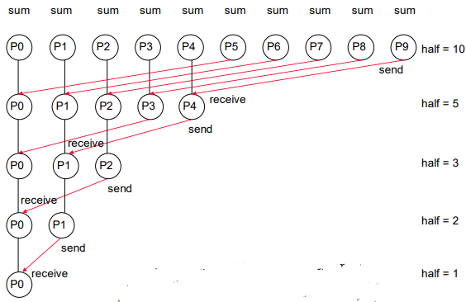
Example
Sum of 100k numbers on 100 processors

Slide 16
Message Passing Paradigm
It is all about exchanging messages
Think of it like a process can receive and send mail.
Analogy: Houses can send mail to each other, but have unique interiors

Slide 17
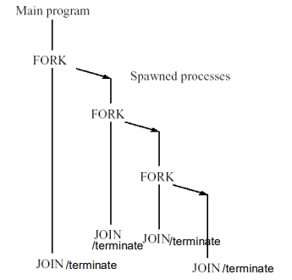
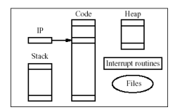
What is a process?

Slide 18
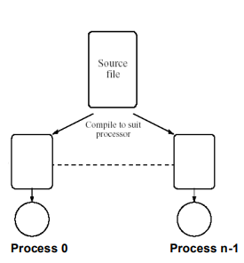
How do we make MPI work?
Creating separate processes and a way to manage messages
We care abut static (SPMD), MPMD outside scope

Slide 19
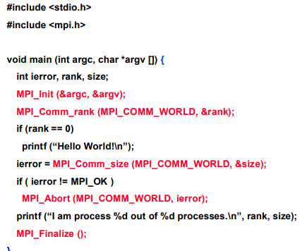
MPI Hello World!

Slide 20
Pt2pt & collectives

Slide 21
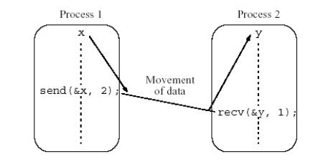
Basic Point to Point
Transfer & Synchronize

Slide 22
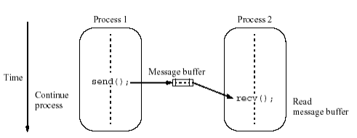
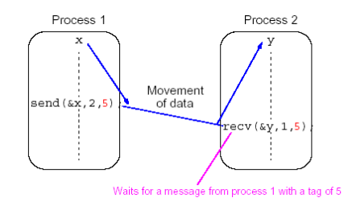
Blocking vs Non-blocking
Blocking – uses message buffer
Non-blocking – immediate return

Slide 23
Communicators
What is the scope of the communication operation?
Originally all processes exist in MPI_COMM_WORLD
You can split this.

Slide 24
Calls
Blocking
MPI_Send – Returns upon local completion
MPI_Recv – Blocks until a message is received
MPI_Isend – Immediate return even if source location is unable to be altered
MPI_Irecv – Returns even if no message exists to receive
MPI_Wait – Waits until operations are done (after nonblocking)

Slide 25
Underlying Information
You will never lose a message
Messages will arrive in the order they were posted
Each Recv only gets one message
Length of received can be shorter than expected

Slide 26
Collectives
Act on all processes
Gets called on all processes
May or may not synchronize everything

Slide 27
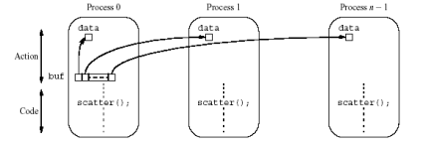
MPI_Scatter

Slide 28
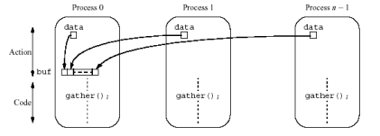
MPI_Gather

Slide 29
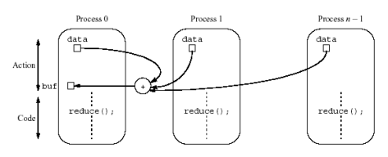
MPI_Reduce

Slide 30
What if we had…
One million processes each summing two numbers?

Slide 31
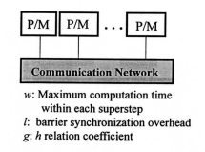
BSP Model
Supersteps
  Computation
  Communication
  Barrier

Slide 32

Time Decomposition
$$T_{total}=T_{comp}+T_{mem}+T_{comm}+T_{sync}$$

Slide 33
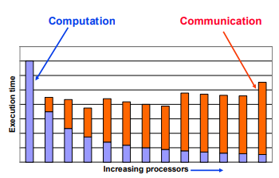
Scalability

Slide 34
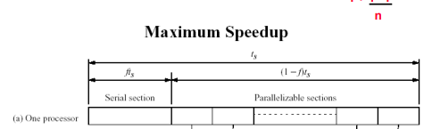
Scalability

Slide 35
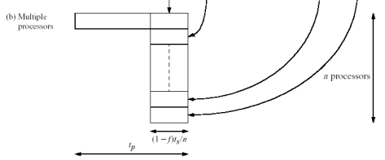
Scalability

Slide 36

Amdahl’s Law
Fixed workload, as such we can divide it…

Slide 37

Gustafson’s Law
Problem size is no longer constant, should scale linearly
Now each processor has the workload W
Also called scaled speedup

Slide 38

Sun and Ni’s Law
Memory exists! We are limited by the space available
G(n) is the increase in workload as memory increases n times
G(n) =1, G(n) = n, G(n) > n

Slide 39
Other Things
Karp-Flatt Metric
Isoefficiency Metric/Relation
Scalability Function

Slide 40
Practice
Sum 100 numbers with MPI
Merge Sort with MPI
Look at MPI Docs

